Slide 1
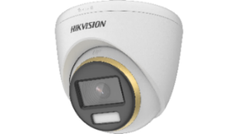
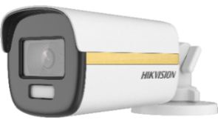
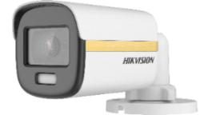
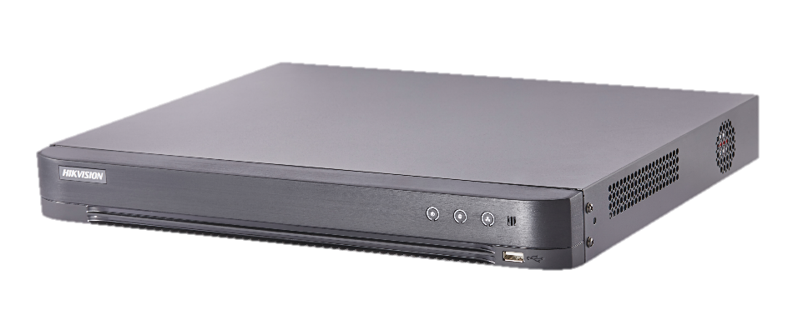
2021 H1
Turbo HD Roadmap
Turbo HD Camera
Turbo HD DVR

Slide 2
Contents
Analog Roadmap
Turbo HD Camera
DVR

Slide 3

Product System – Camera
Audio models
Audio models
U1T
4K
U0T
U7T
U8T
UF3T
KF3T
3K
KF0T-S
5 MP
H0T
H8T
HFT
H0T-PIRL(O)
DF3T-PIRXOS
DFT-PIRXOF
D0T-PIRXF
DF8T
Live Guard
Real-time alert
1080p
D3T
DF3T
DF0T
D8T-PIRL(O)
D0T
D8T
D9T
DFT
D0T-PIRL(O)
720p
C0T
Value
Pro
Ultra
IoT

Slide 4




Turbo HD
Family
F1.0 large aperture
2021.1
4K
UF3T-E
2021.2
2021.2
3K
KF0T-S
KF3T
3K: 5 MP (16:9)
HFT-E
5 MP
HFT
DF3T-S
DF8T-S
DF8T-Z
IP68
1080p
DF0T
DF3T
DF8T
IP68
DFT
Performance

Slide 5
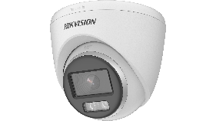
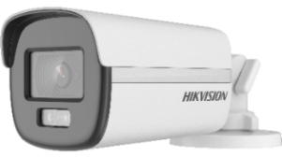
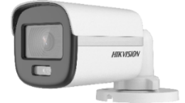

Turbo HD Camera
Turbo HD
2020.Q3
2020.Q4
2021.Q1
2021.Q2
2021.Q3
7 8 9
10 11 12
1 2 3
4 5 6
7 8
3K ColorVu AoC Camera
KF0T-S Series
DS-2CE10KF0T-FS
DS-2CE10KF0T-PFS
DS-2CE12KF0T-FS
DS-2CE70KF0T-MFS
DS-2CE70KF0T-PFS
DS-2CE72KF0T-FS
3K (5 MP, 16:9, 2960*1665)
F1.0 large aperture
0.001 lux
2.8/3.6 mm (6 mm only for large bullet)
20/40 m lighting distance
AoC
MP: 2021.2
Camera
Supporting 3K encoding DVRs:
K Series in V4.25.000 (released)
M Series in V4.26.130 (the end of March)
MP : Release time ES : Sample time
Notes:
现状：1、5MP输出为4:3，与现有市场通用显示器比例不符，会造成画面拉伸；2、H0T现有默认输出分辨率是4 MP 16:9, 2560*1440，实际分辨率为368万。
3K 5MP 16:9 解决了高分辨率与显示屏比例匹配的问题，提升5 MP视觉体验。
筒机有6 mm镜头

Slide 6
Turbo HD Camera
Turbo HD
2020.Q3
2020.Q4
2021.Q1
2021.Q2
2021.Q3
7 8 9
10 11 12
1 2 3
4 5 6
7 8
3K ColorVu Camera
KF3T Series
3K (5 MP, 16:9, 2960*1665)
F1.0 large aperture
0.0005 lux
2.8/3.6 mm (6 mm only for large bullet)
20/40 m lighting distance
MP: 2021.2
DS-2CE10KF3T
DS-2CE12KF3T
DS-2CE72KF3T
Camera
Supporting 3K encoding DVRs:
K Series in V4.25.000 (released)
M Series in V4.26.130 (the end of March)
MP : Release time ES : Sample time
Notes:
大筒机有6 mm镜头
KF3T 全金属

Slide 7
Turbo HD Camera
Turbo HD
2020.Q3
2020.Q4
2021.Q1
2021.Q2
2021.Q3
7 8 9
10 11 12
1 2 3
4 5 6
7 8
4K ColorVu PoC Camera
UF3T-E Series
F1.0 large aperture
0.0005 lux
2.8/3.6 mm
20/40 m lighting distance
PoC
MP: 2021.1
DS-2CE12UF3T-E
DS-2CE10UF3T-E
DS-2CE72UF3T-E
Camera
MP : Release time ES : Sample time
Notes:
大筒机有6 mm镜头
UF3T 全金属

Slide 8
2020 baseline product discontinuation information
C2T (E2)
C5T (E2)
H5T-E (E2)
Discontinued Product Models | Suggested Replacement Models
DS-2CE16C2T-IR | DS-2CE16C0T-IR
DS-2CE16C2T-IRP | DS-2CE16C0T-IRP
DS-2CE16C2T-IT1 | DS-2CE16C0T-IT1
DS-2CE16C2T-IT3 | DS-2CE16C0T-IT3
DS-2CE16C2T-IT5 | DS-2CE16C0T-IT5
DS-2CE16C2T-VFIR3 | NA
DS-2CE56C2T-IR | DS-2CE56C0T-IR
DS-2CE56C2T-IRM | DS-2CE56C0T-IRM
DS-2CE56C2T-IRP | DS-2CE56C0T-IRP
DS-2CE56C2T-IT1 | DS-2CE56C0T-IT1
DS-2CE56C2T-IT3 | DS-2CE56C0T-IT3
DS-2CE56C2T-VFIR3 | NA
Discontinued Product Models | Suggested Replacement Models
DS-2CE16C5T-IT5 | DS-2CE16D8T-IT5F
DS-2CE56C5T-IT3 | DS-2CE56D8T-IT3F
DS-2CE16C5T-AIT3Z | DS-2CE16D8T-AIT3ZF
DS-2CE5AC5T-AVPIT3Z | DS-2CE5AD8T-AVPIT3ZF
DS-2CE56C5T-IT3Z | DS-2CE56D8T-IT3ZF
Discontinued Product Models | Suggested Replacement Models
DS-2CE16H5T-IT1E | DS-2CE16H8T-IT1F
DS-2CE16H5T-IT3E | DS-2CE16H8T-IT3F
DS-2CE16H5T-IT5E | DS-2CE16H8T-IT5F
DS-2CE16H5T-ITE | DS-2CE16H8T-ITF
DS-2CE56H5T-IT1E | DS-2CE78H8T-IT1F
DS-2CE56H5T-IT3E | DS-2CE78H8T-IT3F
DS-2CE56H5T-ITME | DS-2CE76H8T-ITMF
DS-2CE56H5T-VPITE | DS-2CE57H8T-VPITF
DS-2CE16H5T-IT3ZE | DS-2CE19H8T-AIT3ZF
DS-2CE56H5T-IT3ZE | DS-2CE79H8T-AIT3ZF
DS-2CE56H5T-ITZE | DS-2CE56H8T-AITZF
DS-2CE56H5T-VPIT3ZE | DS-2CE59H8T-AVPIT3ZF
Notes:
C0T中性全部停产、C2T/C5T全部停产、H5T-E停产

Slide 9
2020 baseline product discontinuation information
C0T中性停产 (E2)
Discontinued Product Models | Suggested Replacement Models
DS-2CE16C0T-IR(2.8mm)(O-NEU)(B) | /
DS-2CE16C0T-IRF(2.8mm)(O-NEU) | /
DS-2CE16C0T-IRP(2.8mm)(O-NEU)(B) | /
DS-2CE16C0T-IRPF(2.8mm)(O-NEU) | /
DS-2CE16C0T-IT1(3.6mm)(O-NEU)(B) | /
DS-2CE16C0T-IT1F(2.8mm)(O-NEU) | /
DS-2CE16C0T-IT3(3.6mm)(O-NEU)(B) | /
DS-2CE16C0T-IT3F(2.8mm)(O-NEU) | /
DS-2CE16C0T-IT5(3.6mm)(O-NEU)(B) | /
DS-2CE16C0T-IT5F(2.8mm)(O-NEU) | /
DS-2CE56C0T-IR(3.6mm)(O-NEU)(B) | /
DS-2CE16C0T-IR(2.8mm)(O-NEU)(B) | /
Discontinued Product Models | Suggested Replacement Models
DS-2CE56C0T-IRF(2.8mm)(O-NEU) | /
DS-2CE56C0T-IRM(2.8mm)(O-NEU)(B) | /
DS-2CE56C0T-IRMF(2.8mm)(O-NEU) | /
DS-2CE56C0T-IRMM(2.8mm)(O-NEU)(B) | /
DS-2CE56C0T-IRMMF(2.8mm)(O-NEU) | /
DS-2CE56C0T-IRP(2.8mm)(O-NEU)(B) | /
DS-2CE56C0T-IRPF(2.8mm)(O-NEU) | /
DS-2CE56C0T-IT1(6mm)(O-NEU)(B) | /
DS-2CE56C0T-IT1F(2.8mm)(O-NEU) | /
DS-2CE56C0T-IT3(3.6mm)(O-NEU)(B) | /
DS-2CE56C0T-IT3F(2.8mm)(O-NEU) | /
DS-2CE56C0T-IRF(2.8mm)(O-NEU) | /
DFT-C (E1, 2021Q1 E2)
Discontinued Product Models | Suggested Replacement Models
DS-2CE12DFT-FC | DS-2CE12DFT-F
DS-2CE12DFT-FC28 | DS-2CE12DFT-F
DS-2CE72DFT-FC | DS-2CE72DFT-F
DS-2CE72DFT-FC28 | DS-2CE72DFT-F
Discontinued Product Models | Suggested Replacement Models
DS-2CE10DFT-FC | DS-2CE10DFT-F
DS-2CE10DFT-FC28 | DS-2CE10DFT-F
DS-2CE10DFT-PFC28 | DS-2CE10DFT-PF

Slide 10
Contents
Analog Roadmap
Turbo HD Camera
DVR

Slide 11

Product System – DVR
Audio models
4K
73HT-K
90HT-K
72HT-K
81HT-K
73HU-K
90HU-K
5 MP
7216HU-K
81HU-K
71HU-K
DVS: 67HU-K
7204/08HU-K
iDS-72HU-M
73HQ-K
81HQ-K
1080p
7224/32HQ-K
71HQ-K
7204/08/16HQ-K
iDS-72HQ-M
1080p lite
&
720p
7116HG-K
7216HG-K
*71HG-F(/N)
*72HG-F(/N)
Value
Pro
Ultra
Special
* Non AoC models: 8/16HG-F，24/32HG-K

Slide 12
Turbo HD DVR
Turbo HD
2020.Q4
2021.Q1
2021.Q2
10 11 12
1 2 3
4 5 6
iDS-7204HUHI-Mx (C)
The (C) version to be released
Late Feb
Firmware 4.26.120
iDS-7204/08HQHI-Mx (C)
M series
DVR
Late Jan
Firmware 4.26.110
The (C) version to be released
iDS-7204HUHI-Mx (C)
iDS-7204/08HQHI-Mx (C)
3K camera will be supported;
Supports speed-up playback and downing footage on Hik-Connect App.
Late March
Firmware 4.26.130

Slide 13
Turbo HD DVR
Turbo HD
2020.Q4
2021.Q1
2021.Q2
10 11 12
1 2 3
4 5 6
DS-7104HQHI-K1(C)
DS-7204HQHI-K1/E(C)
Firmware 4.30.300
The (C) version to be released and the interface will be upgraded to E-UI.
Late Jan
K series
DVR
DS-7108/16HQHI-K1
DS-7208/16HQHI-K1/E
Firmware 4.30.300
The interface will be upgraded to E-UI.
Late Jan
DS-7x16HGHI-K1(C)
DS-7108HQHI-K1(C)
DS-7208HQHI-K1/E(C)
Firmware 4.30.300
The (C) version to be released.
Late May

Slide 14
Turbo HD DVR Switch Plan
1
HGHI
HGHI (C) Version
71HQH-K
71HQHI-K (C) Version
2
HQHI
72HQHI-K
72 HQHI-M
71HUHI-K
71HUHI-K (C) Version
3
HUHI
72HUHI-K
72HUHI-M
4
M Series
M(C) Series

Slide 15

Thanks!
International Product and Solution Center

